Slide 1
Exploring Tradeoffs Between Power and Performance for a Scientific Visualization Algorithm
Stephanie Labasan
Computer and Information Science
University of Oregon
23 November 2015

Slide 2
Overview
Motivation: Power is becoming a leading design constraint in HPC
Goal: Save energy/power
Idea: Reduce CPU clock frequency
Works because visualization is data-intensive
Proposition for users: Run X% slower, save Y% in energy/power
Study: Consider a visualization algorithm (isosurfacing) and investigate which factors most affect X and Y
Notes:
Our study was motivated by the fact that power is becoming a leading design constraint in HPC..
One idea to achieving this goal is to reduce clock freq, which is well-suited for visualization because visualization is data-intensive. This leads to the following proposition for users: if you’re willing to run X% slower, then you can save Y% in energy/power.

Slide 3
Outline
Motivation & Background
Strategy & Research Questions
Experimental Overview
Results
Takeaways
Notes:
First, I’ll cover some background information.

Slide 4

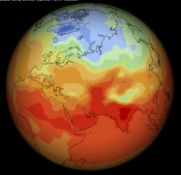
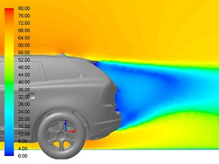

High-Performance Computing
Enabling technology for scientific discoveries
Weather prediction, design simulation, genomics research, medical imaging, and more!
More cost-efficient to buy a supercomputer than building an actual experiment
Notes:
HPC is an enabling technology allowing our scientists and engineers to solve the most complx scientific problems. These applications, such as climate and weather prediction, genomics research, and medical imaging, are unique in that they require high bandwidth, large amounts of storage, and high computational resource. Typically these applications require more than 1 order of magnitude more computational resources than is available on a workstation. So we look to HPC system as they provide us with the resources needed to solve these problems are are more cost-efficient than building the physical experiment.

Slide 5
Large Supercomputers
Performance measured in FLOPs = floating point operations per second
1 GigaFLOP = 1 billion FLOPs
1 TeraFLOP = 1,000 GigaFLOPs
1 PetaFLOP = 1 million GigaFLOPs → today
1 ExaFLOP = 1 billion GigaFLOPs → expected 2020
c/o H Childs
Notes:
In order to get a sense of how large and powerful these supercomputers are, we look at their performance measured in FLOPs or the number of floating point operations the system can do in a single second. The performance is determined when running a highly optimized, computationally intensive benchmark known as Linpack.

Slide 6
Power Costs
1 MW of power costs $1M per year
Supercomputing centers are paying ~$10M
As machines get larger, cost rises, unless we innovate power-efficient techniques
Techniques may come from HW, but SW as well
Rank | System | Cores | Rmax (PFLOPS) | Power (MW)
1 | Tianhe-2, China | 3.12M | 33.9 | 17.8
2 | Titan, ORNL | 560K | 17.6 | 8.2
3 | Sequoia, LLNL | 1.57M | 17.2 | 7.9
4 | K computer, Japan | 705K | 10.5 | 12.7
c/o Top500, Jun2015
Notes:
Twice a year, the HPC community releases a list known as the Top500, which ranks the top supercomputers by the FLOPS metric. On the right I show the top 4 supercomputers as of this past June. In addition to their high computational performance, they also have high power consumption. The typical assumption is that 1 MW of power cost…

Slide 7
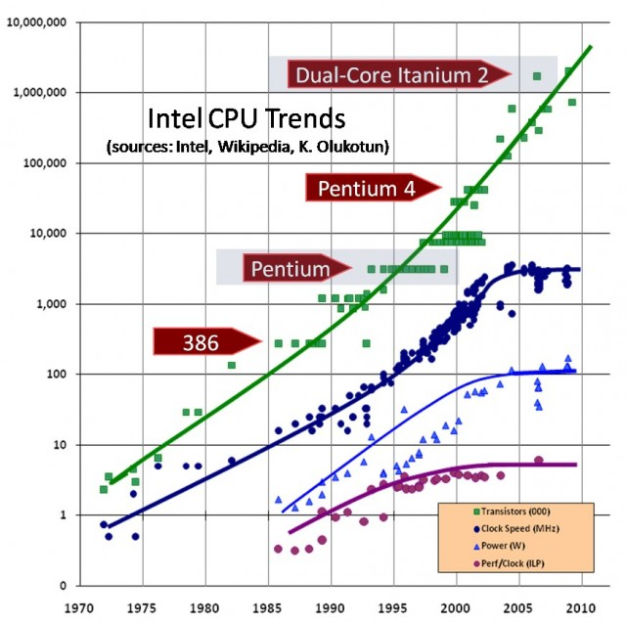
Power Problem
Pre-2000s
Today
No longer limited by available HW resources
Thermal heat ≈ CPU frequency
System design shifting from hardware to software design
Moore’s Law
Power
Clock Freq
c/o http://www.extremetech.com/computing/
Notes:
Let’s look at the root of this problem. The design of our systems is no longer limited by the available space on the processors, but by the amount of heat generated by the processors. On the right, we have show trends in metrics for different Intel processors. If we focus on the year 2000 and before, we see Intel 386 to Intel Pentium have steadily increased in transistor counts, consistent with Moore’s Law. With the goal in mind of improving performance from one processor to the next, we see a rise in the clock frequency. As a result, the power consumption also rises.
Now let’s focus on 2000 to the future. Moore’s law has continued to hold strong and our transistor counts continue to steadily increase. But, now we’re seeing a saturation in the clock frequency and power consumption. Dennard scaling, which enabled us to maintain a constant power density when reducing the size of the transistors by scaling down the voltage and current is starting to breakdown. In other words, we can no longer reduce the transistor size and achieve constant power density because we can’t reduce the voltage and current any lower. So by adding more transistors to the processor, we’re simply adding to the power consumption of the chip, which is nearing the thermal limit and our ability to dissipate the heat generated by the large number of transistors. Because we cannot dissipate any more heat, this has limited the clock frequency that we can run our processors at.

Slide 8
Energy vs. Power
Energy
Power
Units: Joules
Total work done
Monthly bill from electric company (e.g., $.11/kWh) – “power bill”
Units: Joules/s, Watts
Rate of energy usage
Notes:
Before we dive any further, let’s define some key terms

Slide 9
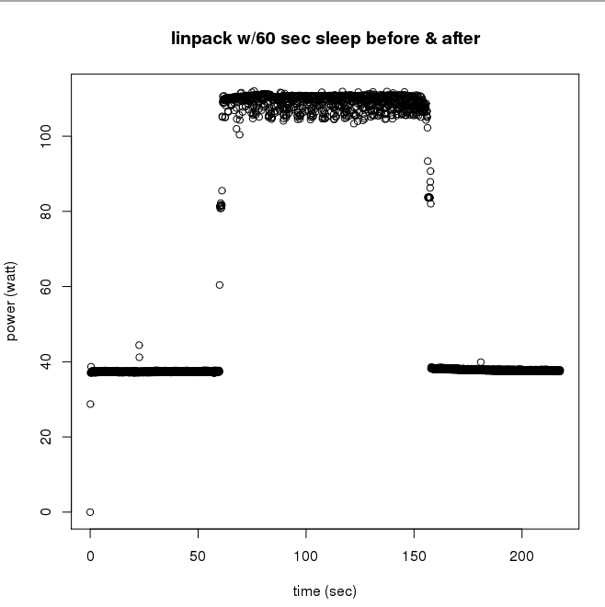
CPU Power Usage Varies Over Time
Base power usage for idle state
When more HW components are engaged (cache, vector units, etc.), power rises
Energy usage would be the area under this power curve
Computationally-intensive HPC benchmark (Linpack) running on small cluster
Notes:
The power that a processor uses will vary over the lifetime of an application.

Slide 10
Save Energy/Power?
Energy
Power
For a single application execution, minimize energy consumption ($$)
Energy-to-solution
Workstations, data centers
Reduce rate at which application consumes energy
Save power != Save $$/energy
Run at 40W take 10s = 400J
Run at 30W take 15s = 450J
Increase throughput (concurrent jobs)
Supercomputers
Notes:
Users running on workstations at home may want to reduce energy usage to minimize monthly bills. There are also some data centers that enforce an energy bound on a per job basis, so it's up to the application developers to ensure their algorithms are energy efficient

Slide 11
Increasing Throughput
Scenario 1
Scenario 2
Launch a single job with maximum power allocation available
No other concurrent jobs can be launched without exceeding the bound
Launch the same job at a lower power allocation, job runs longer
Power available to launch other concurrent jobs → increase number of completed jobs
System Power Bound
System Power Bound
Job1
Job3
Power
Power
Job2
Job1
Time
Time
Notes:
Let’s assume we have a system power bound. We have two scenarios. First, we could launch a single job and have it consume all the power during its execution. This means we can’t simultaneously launch any other jobs without exceeding the bound.

Slide 12
Department of Energy Perspectives on Exascale Challenges
Systems | 2009 | “2018” “2020” | Difference Today & 2018 2020
System peak | 2 Pflop/s | 1 Eflop/s | O(1000)
Power | 6 MW | ~20 MW | ~3
System memory | 0.3 PB | 32-64 PB [.03 Bytes/Flop] | O(100)
Node performance | 125 GF | 1,2 or 15 TF | O(10)-O(100)
Node memory BW | 25 GB/s | 2- 4 TB/s [.002 Bytes/Flop] | O(100)
Node concurrency | 12 | O(1k) or 10k | O(100)-O(1000)
Total Node Interconnect BW | 3.5 GB/s | 200-400GB/s | O(100)
System size (nodes) | 18,700 | O(100,000) to O(1M) | O(100)-O(1000)
Total Concurrency | 225,000 | O(billion) [O(10) to O(100) for latency hiding] | O(100)
Storage | 15 PB | 500-1000 PB (>10x system memory in min) | O(10)-O(100)
IO | 0.2 TB | 60 TB/s (how long to drain the machine) | O(100)
MTTI | Days | O(1 day) | - O(10)
Systems | 2009 | “2018” “2020”
System peak | 2 Pflop/s | 1 Eflop/s
Power | 6 MW | ~20 MW
Until now, innovations in power savings have been hardware driven.
However, to reach 1 Exaflop/20 MW, software improvements may be needed.
c/o P Beckman
Notes:
The DoE has defined its perspectives on the challenges at exascale, which are presented here in this table. I want to focus our attention on two of them here.
In 2009 when this slide was made, the challenge to achieving exascale was increasing computation by 3 orders of magnitude but only increasing power consumption by 1 order of magnitude. In other words, we needed to be 100X more power-efficient. Since then, there have been several power-efficiency innovations to reduce the power-efficient factor. These have mostly been driven by hardware, such as the integration of GPU and many-core. As we near 2020 when we expect to see the first exascale machine, in order to reach our goal at the 20MW power cap set by the Dept of Energy, software improvements may also be needed to complement our hardware solutions.

Slide 13
Power on Future HPC Systems
Two scenarios:
Machine’s max power consumption <= 20 MW
i.e., even Linpack stays <= 20 MW
Machine’s max power consumption > 20 MW
Controls needed to enforce power usage at 20 MW cap
Power allocation would need to be coordinated by a central manager
Our study is important for scenario (2), but also has cost saving implications for (1).
Notes:
There are two scenarios for what power will look like on future HPC systems.

Slide 14
Last two years…
Different visualization algorithms (volume rendering, particle advection, isosurfacing, …)
Different implementations using various visualization software libraries, such as VTK, Dax, EAVL
Building a “toolkit”:
Power profiles → attribution
Tunable knobs to improve power efficiency
Notes:
VTK, a popular visualization toolkit, widely used today. Dax and EAVL were two solutions to visualization at exascale, which have been merged to become a collaboratorive solution known as VTK-m.
Dax Toolkit: Sandia Nat’l Lab
EAVL (extreme scale analysis and visualization library): ORNL

Slide 15
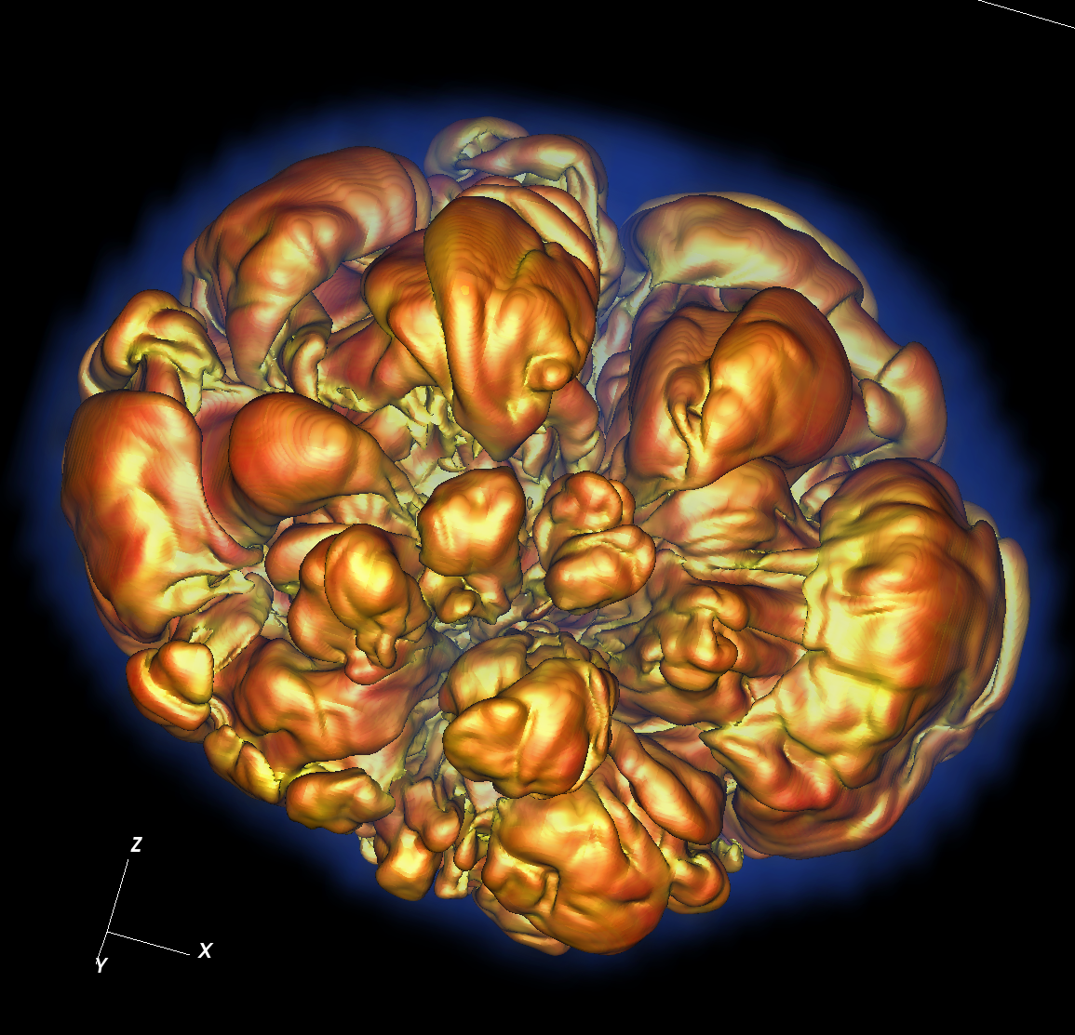
Isosurfacing
Isolines: Represent where a field is constant
Isosurface: 3D object, where every point is a constant value
Method:
Iterate over all cells
Compare cell to isovalue (or range of isovalues)
Write valid cells into new data set
Throw out invalid cells
Temperature of Star Explosion: Isosurface
Contour Map: isolines
Notes:
Isosurfacing is a standard visualization technique for extracing a surface of constant value. In 2D, a single isoline of a topological map shows where the altitude is constant. In 3D, we can extract a surface representing a constant field of interest, such as temperature or pressure.

Slide 16
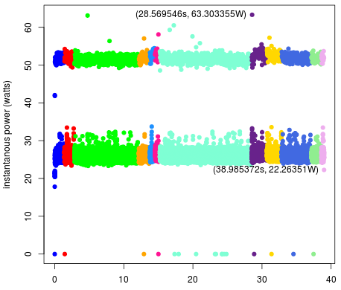
Isosurfacing Workload & Power
Power profile primarily consistent with idle state (20W-30W)
Power jumps to 50W presumably due to cache misses
Disappointing result: little variation in power to optimize.
What about a different power saving strategy?
Notes:
On the right, I show one of our early experiments, which shows the power profile for an isosurfacing algorithm. We see that the power profile is primarily consistent with idle. This was a disappointing result because there is little variation in power for us to optimize. So, we needed to find a different technique to make our visualization algorithms more power-efficient.

Slide 17
Outline
Motivation & Background
Strategy & Research Questions
Experimental Overview
Results
Takeaways

Slide 18

Power Saving Technique: Reduce CPU Clock Frequency
Outcome: Takes longer to run, but uses less power
Why: Non-linear relationship between frequency and power →
Reduced clock frequency results in less power consumption
but, subcomponents still consume power at the same rate
Will lead to power savings
May lead to energy savings, may not
$$P∝f^{3}$$

Slide 19
Data-Intensive Applications
Architecture with separate clock frequencies for cache and compute unit (e.g., Intel Haswell)
Enables reduction of clock frequency without impacting cache
Ideal outcome:
Reduce clock frequency
Achieve energy/power savings
Runtime does not change
Some visualization algorithms are data-intensive

Slide 20
Benchmark Tests
computeBound: Several multiplication ops on a single variable
computeBoundILP: computeBound with instruction-level parallelism for pipelining
memoryBound: Accesses an element in one array and writes it to another based on an index
memoryBoundCacheThrash: memoryBound with randomized output locations, removing any benefit of locality
Vis algorithms??
Vis algorithms??
Notes:
We created 4 benchmark tests that vary in levels of compute and data intensity. Our most compute bound test performed several multiplication operations on a single variable.

Slide 21
Research Questions
Data-intensity: If you reduce the clock frequency by X, does the runtime increase by X? or less?
Energy savings: If you are willing to run X% slower, you can save Y% in energy
Power savings: If you are willing to run X% slower, you can save Z% in power
Notes:
Y and Z may not be related

Slide 22
Outline
Motivation & Background
Strategy & Research Questions
Experimental Overview
Results
Takeaways

Slide 23
Factors Studied
Hardware architectures
2 options
CPU1 | CPU2
Workstation: Intel i7 4770K (Haswell) | Supercomputer: NERSC’s Edison (Ivy Bridge)
4 HT cores @ 3.5 GHz | 12 HT cores @ 2.4 GHz
32 GB memory @ 1600 MHz | 64 GB memory @ 1866 MHz

Slide 24
Factors Studied
Hardware architectures
CPU clock frequency
varies
CPU1 | CPU2
Workstation: Intel i7 4770K (Haswell) | Supercomputer: NERSC’s Edison (Ivy Bridge)
4 HT cores @ 3.5 GHz | 12 HT cores @ 2.4 GHz
32 GB memory @ 1600 MHz | 64 GB memory @ 1866 MHz
11 frequency steps (3.5GHz-1.6GHz, by=200MHz) | 7 frequency steps (2.4GHz-1.2GHz, by=200MHz)
Linux cpufreq-utils tool | ALPS aprun job launcher
Notes:
ALPS: application level placement scheduler

Slide 25
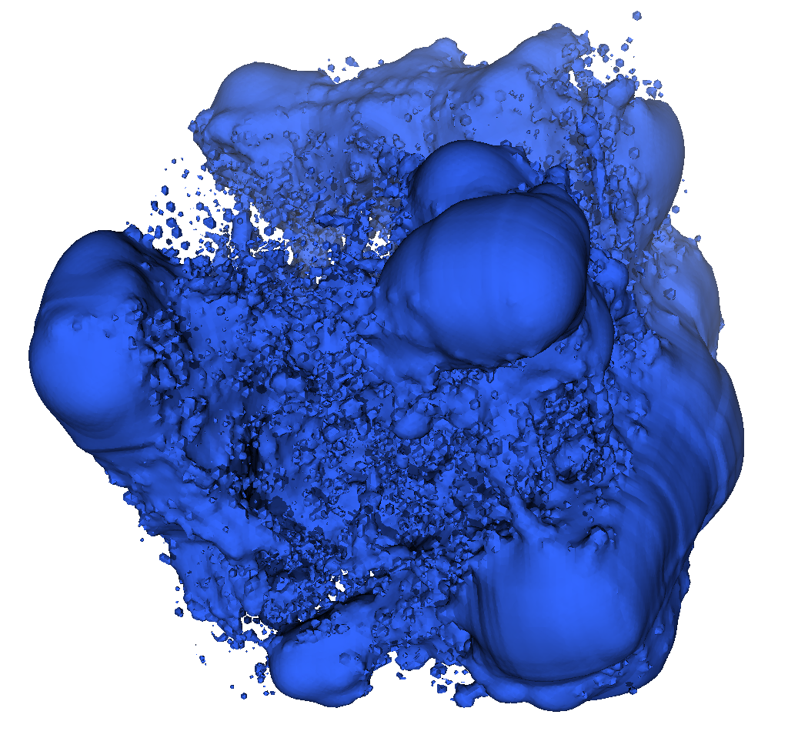

Factors Studied
Hardware architectures
CPU clock frequency
Data set
8 options
Enzo | Nek5000
Cosmology simulation, structured, rectilinear grid to tetrahedrons | Thermal hydraulics simulation, unstructured, hexahedrons to tetrahedrons
Three data sets of varying sizes: Enzo-1M (1.13M), Enzo-10M (10.5M), Enzo-80M (83.9M) | Nek5000 (50M)
Same as above, but increase data-intensity: REnzo-1M, REnzo-10M, REnzo-80M | RNek5000
Isoval: 170 | Isoval: 0.3
Enzo
Nek5000
Notes:
Data sets originated from 2 simulations: Enzo and Nek5000. Our data set generation led to regular cache layouts, we wanted to see what would happen if we had irregular layouts, which is why we increased the data intensity by randomizing the point indices. For the Enzo and Nek5000 data set, we selected 1 isovalue for each.

Slide 26
Factors Studied
Hardware architectures
CPU clock frequency
Data set
Parallel programming model
2 options
Concurrency
4 options
OpenMP: Cores operate on a common data set, enabling opportunity for cache coordination
MPI: Each core operates on a local copy of the data set, leading to uncoordinated cache accesses

Slide 27
Factors Studied
Hardware architectures
CPU clock frequency
Data set
Parallel programming model
Concurrency
Isosurface implementation
2 options
Baseline: Our own implementation that only performs isosurfacing on tetrahedrons using linear interpolation.
General: Implemented using VTK, specifically vtkContourFilter. Algorithm performs isosurfacing in a general way (many cell types, higher order elements, etc.).
Notes:
Supports different data models, different algorithms

Slide 28
Methodology
Factors Studied
Hardware architecture
CPU clock frequency
Data set
Parallel programming model
Concurrency
Isosurface implementation
Study conducted in 6 phases
Phase 1: Vary clock frequency on Baseline Implementation, 1 data set, OpenMP, max concurrency on workstation
Each phase varies 1 factor to investigate effects
Notes:
Sub-sequent

Slide 29
Performance Metrics
Most collected with PAPI
Total instructions executed, total cycles, number of L3 cache misses
Derive instructions per cycle (IPC): metric of data-intensity (e.g., high IPC = compute-intensive, low IPC = data-intensive)
Energy/power measurements
Total energy read from energy MSR
Derive average power consumed from total energy and program runtime
Cray power management infrastructure

Slide 30
Outline
Motivation & Background
Strategy & Research Questions
Experimental Overview
Results
Takeaways

Slide 31
General Notation & Relationships
Clock frequency:
F_{D} = nominal frequency
F_{R} = reduced frequency
For a given application:
Runtime
T_{D} = time taken at freq F_{D}
T_{R} = time taken at freq F_{R}
Energy
E_{D} = energy used at freq F_{D}
E_{R} = energy used at freq F_{R}
Power
P_{D} = power at freq F_{D}
P_{R} = power at freq F_{R}
F_{rat} = F_{D}/F_{R}
T_{rat} = T_{R}/T_{D}
E_{rat} = E_{D}/E_{R}
P_{rat} = P_{D}/P_{R}
If T_{rat} < F_{rat}, then data-intensive application (e.g., does not slowdown proportional to clock frequency)
Energy savings: T_{rat} vs. E_{rat}
Power savings: T_{rat} vs. P_{rat}
No need to be overwhelmed – we’ll go over these in the next slides.
Notes:
Defined some terms, showing them to you now, will go through these in later slides

Slide 32
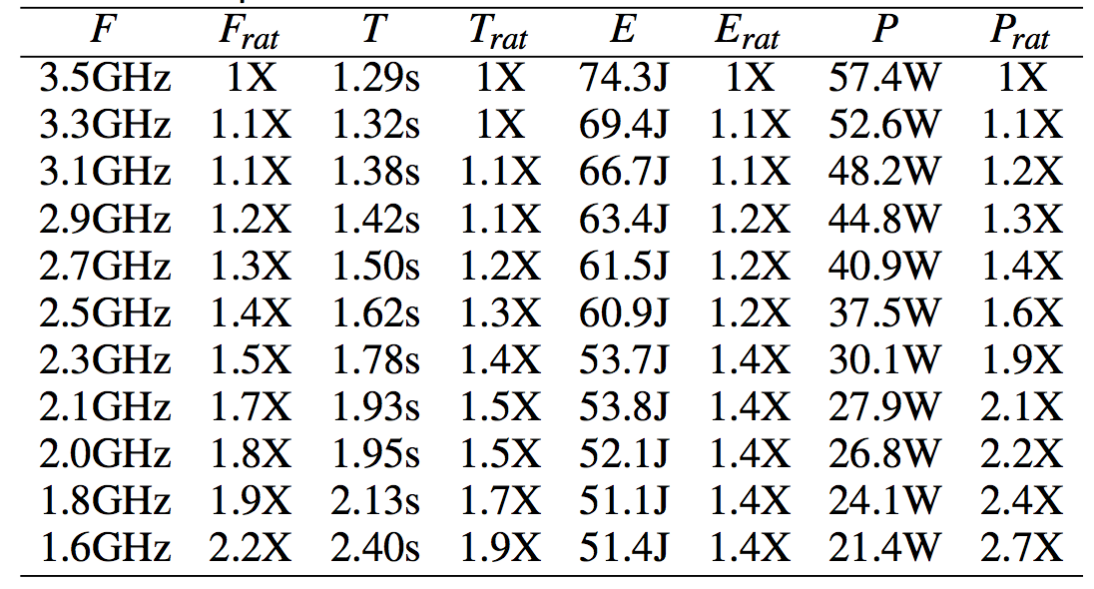
Phase 1 Results: Vary CPU Frequency
Reducing clock frequency by 2.2X:
Runtime: increases by 1.9X
Energy: decreases by 1.4X
Power: decreases by 2.7X
Implementation tends towards compute-intensive, but not as strongly as our compute-bound benchmark
Favorable energy/power savings
Baseline Implementation, Enzo-10M, CPU1, OpenMP

Slide 33
Phase 2 Changes
Changes: Execute our own isosurfacing algorithm on all 8 data sets
Goal: Investigate how data-intensity and size affects our propositions

Slide 34
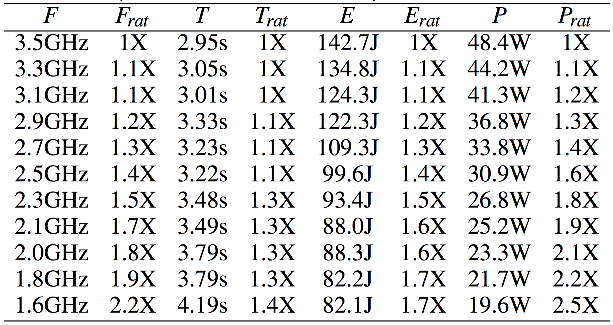
Phase 2 Results: Vary Data Set
Increase data-intensity of data set:
Runtime: increases by 1.4X (versus 1.9X in last slide)
→ More data-intensive than before
Energy: decreases by 1.7X (versus 1.4X in last slide)
Power: decreases by 2.5X (versus 2.7X in last slide) due to increased cache misses
Baseline Implementation, REnzo-10M, CPU1, OpenMP
Notes:
NOTE: What’s specifically changed here is that we’re now using the randomized version of the previous data set, which we call Renzo-10M.
Don’t save as much power as in the previous slide because of the increased cache misses due to the irregular cache layout of our data set.
Increasing intensity of 1 data set from previous slide

Slide 35
Phase 2 Results: Vary Data Set
Smallest data set suffers largest impact to runtime with minimal energy savings
Energy savings: Improves for data sets with increased data-intensity
Cache misses differ across data sets
Smallest data set has largest slowdown and minimal energy savings.
All propositions improve as we increase data-intensity.
Baseline Implementation, CPU1, OpenMP
Notes:
Continuing Phase 2, we ran the same test from the previous slide on the remaining datasets and these are our results.
Here we’re only looking at the ratio between default (3.5GHz) and lowest frequency (1.6GHz)

Slide 36
Phase 3 Changes
Changes: Use MPI instead of OpenMP to implement our own isosurfacing algorithm and perform isosurfacing on all 8 data sets
Goal: Investigate the effects of non-coordinated cache accesses on our algorithm

Slide 37
Parallel Model Differences
MPI
OpenMP
Each rank loads in a local copy of the data set
Each rank iterates over all cells in their local data
Program loads data set
Data set is split among threads, and each thread performs isosurface on a subset of cells
Repeat, such that each thread iterates over all cells (same amount of work as MPI)

Slide 38
Phase 3 Results: Vary Programming Model
Non-randomized data sets
Two clusters: Increase data-intensity of data set causes less impact to runtime
Energy savings: Larger energy savings than OpenMP (1.7X vs. 2X)
Randomized data sets
Baseline Implementation, CPU1, MPI
Notes:
With MPI, our clusters become more distinct. We have our non-randomized data sets slowing down proportional to the clk freq. Our randomized data sets have a smaller slowdown. We find that the differences between our two programming models greatly affects the slowdown of our data sets because of the method in which it uses memory.
Explain difference in memory usage between mpi and openmp (distinct clusters)

Slide 39
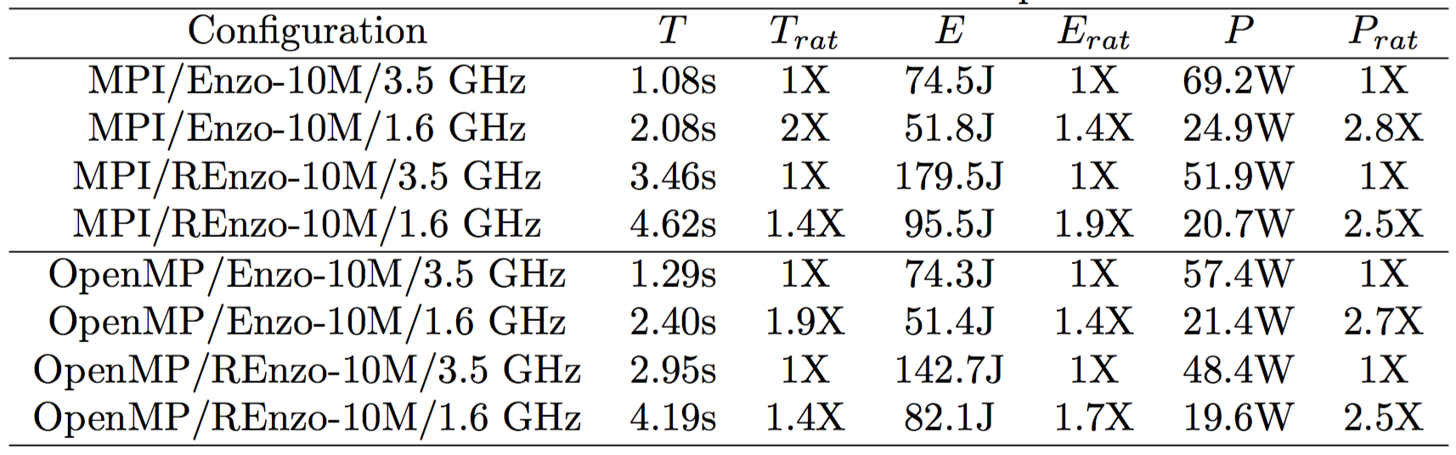
Phase 3 Results: Vary Programming Model
Energy savings: Better with MPI than with OpenMP, MPI uses more energy
→ MPI process is heavier weight than OpenMP thread
Power savings: MPI uses more power than OpenMP, especially on randomized data set
→ MPI makes less efficient use of memory than OpenMP
Notes:
Summarizing Phase 3, we see that our MPI implementation uses more energy and more power than OpenMP. We attribute the high energy usage to the fact that an MPI process is heavier weight than an OpenMP thread. And we attribute the high power consumption to the fact that MPI is make less efficient use of the memory subystem.

Slide 40
Phase 4 Changes
Changes: Increase the level of concurrency when executing the OpenMP and MPI implementations of our own isosurfacing algorithm
Goal: Investigate the effects of increased memory requests between the two programming models

Slide 41
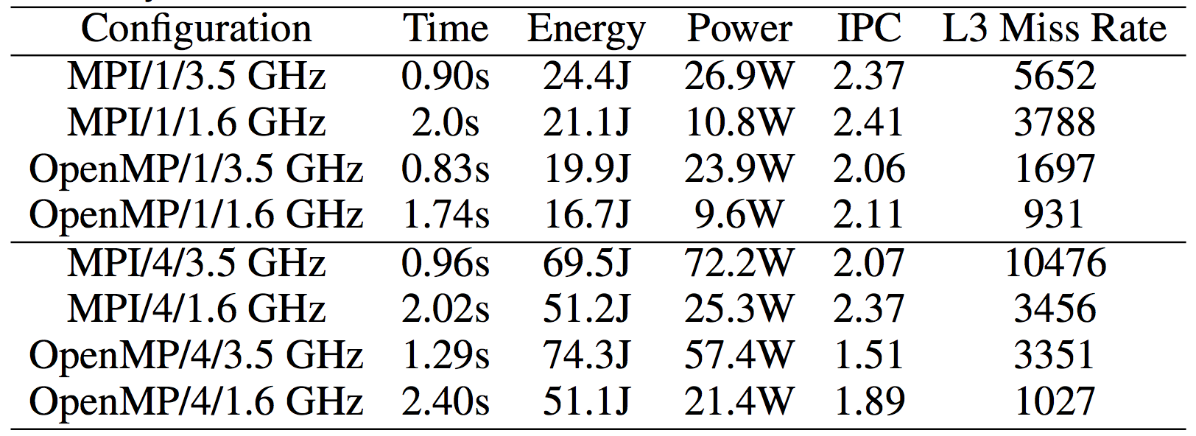
Phase 4 Results: Vary Concurrency
Power savings @1 core: MPI and OpenMP save 2.5X
Power savings @4 cores: MPI saves 2.8X and OpenMP saves 2.68X
Increasing concurrency causes more memory requests, leading to memory BW saturation (less instructions executed) and increased L3 misses
BaselineImplementation, Enzo-10M, CPU1, MPI/OpenMP

Slide 42
Phase 5 Changes
Changes: Implement the isosurfacing algorithm using VTK’s contour filter
Goal: Investigate the effects of using a different implementation, specifically an implementation using general-purpose visualization library that is designed for diverse usage (e.g., cell types, higher order elements, etc.)

Slide 43
Algorithm Implementation Differences
Baseline Implementation
General Implementation – VTK
Pre-compute correct answers for all cases and store in a lookup table
For each cell in data set, identify which case it is in
Use lookup table to generate isosurface
Visualization Toolkit
Open source visualization software toolkit
Enables computer graphics, visualization, and image processing
vtkContourFilter *cf;
cf->SetNumberOfContours(1);
cf->SetValue(170,isoval);
cf->Update();

Slide 44
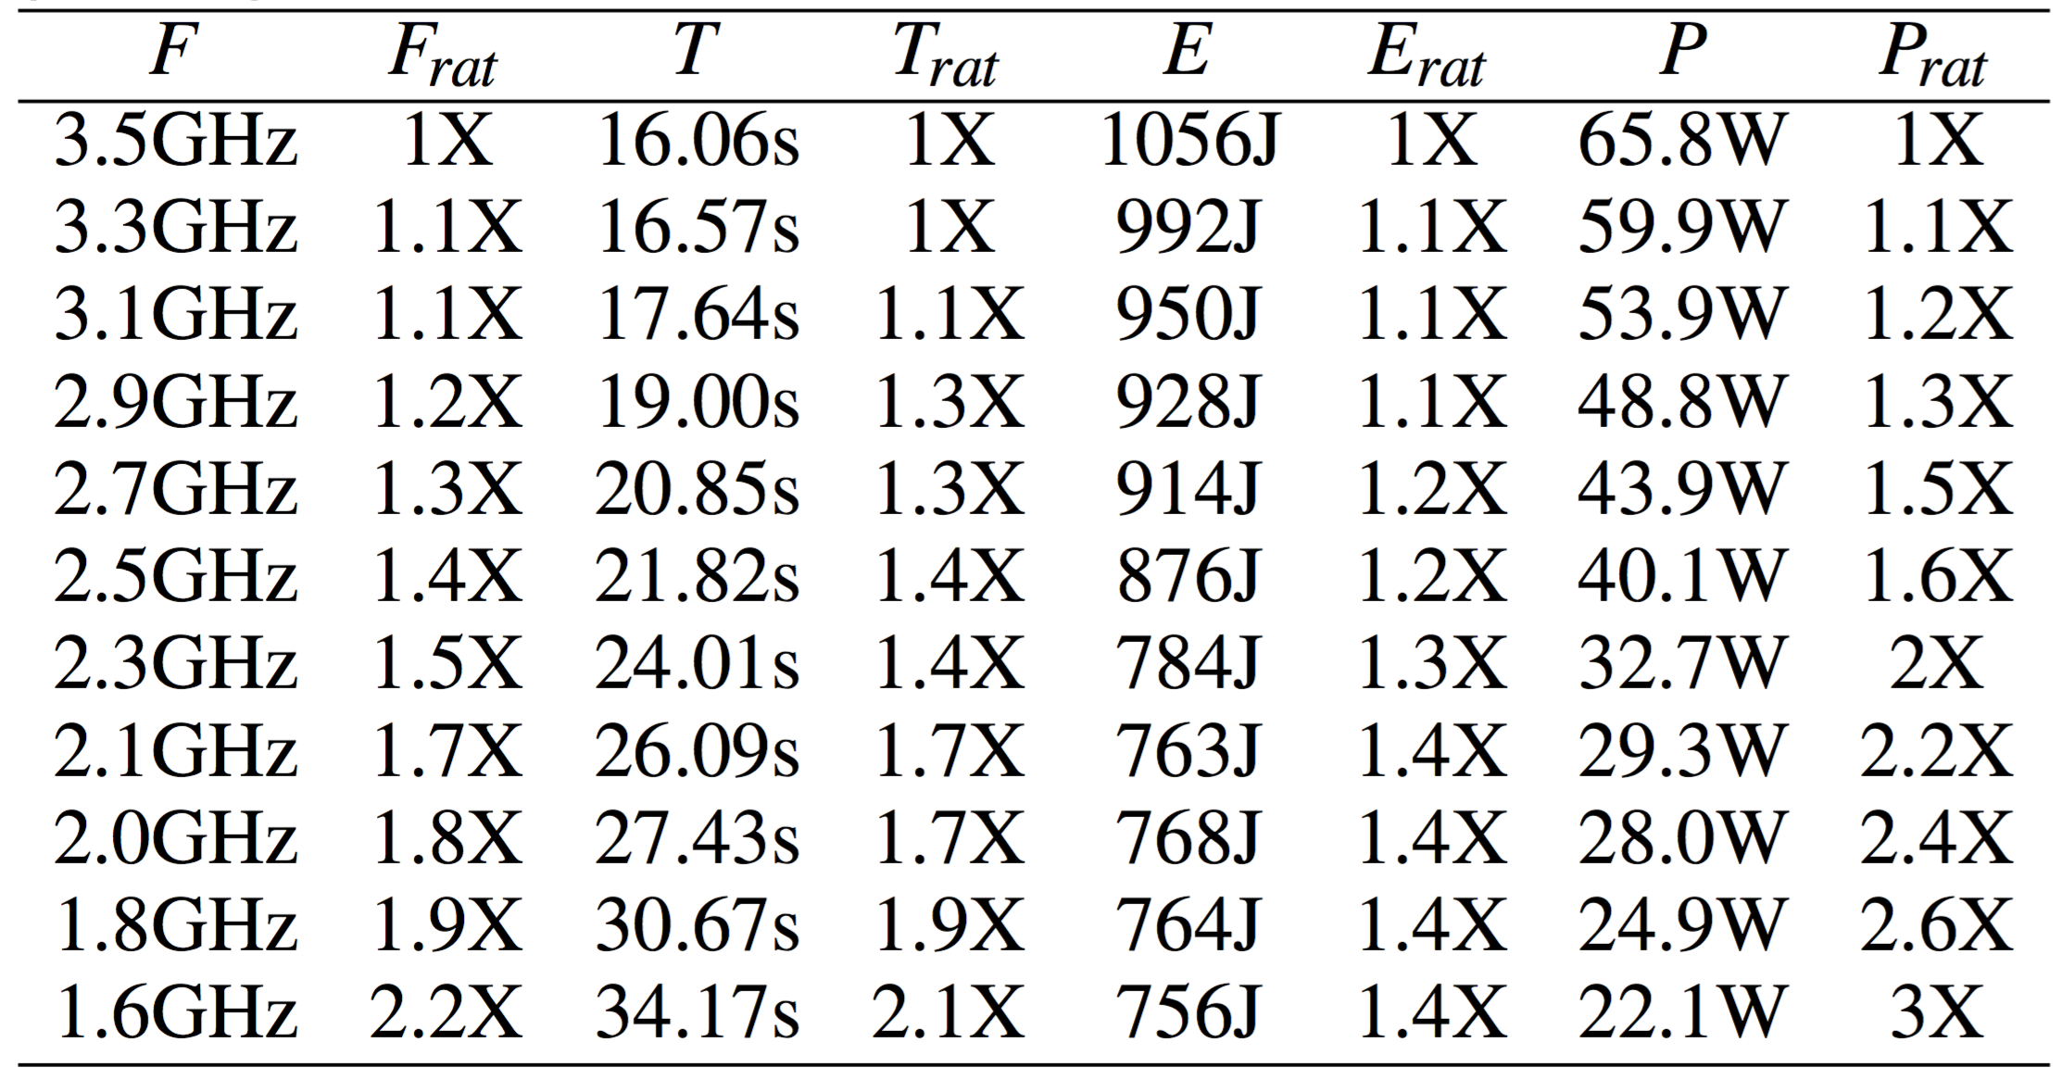
Phase 5 Results: Vary Algorithm Implementation
Compute-intensive: F_{rat} and T_{rat} are highly correlated
Number of instructions issued differs between implementations (102 billion vs. 7 billion)
Algorithm shifts from data- to compute-intensive and propositions become less favorable
General Implementation, Enzo-10M, CPU1, OpenMP

Slide 45
Phase 6 Changes
Changes: Execute our own implementation with MPI on a different processor architecture
Shared clock frequency between cache and compute unit
In previous phases, clock frequency was decoupled
Goal: Investigate the effects of alternate hardware architectures
Notes:
Decoupled clock frequency in previous architecture/tests

Slide 46
Decoupled Clock Frequency
Core: Components of CPU involved in executing instructions
Uncore: Components closely connected to the core to reduce access latency
Intel architectures & clock frequency
Ivy Bridge: shared
Haswell: separate
Core
Uncore
Notes:
Core: ALU, FPU, private L1 and L2 cache
Uncore: L3 shared cache, memory controller, QPI controller (Intel QuickPath Interconnect, point-to-processor interconnect)

Slide 47
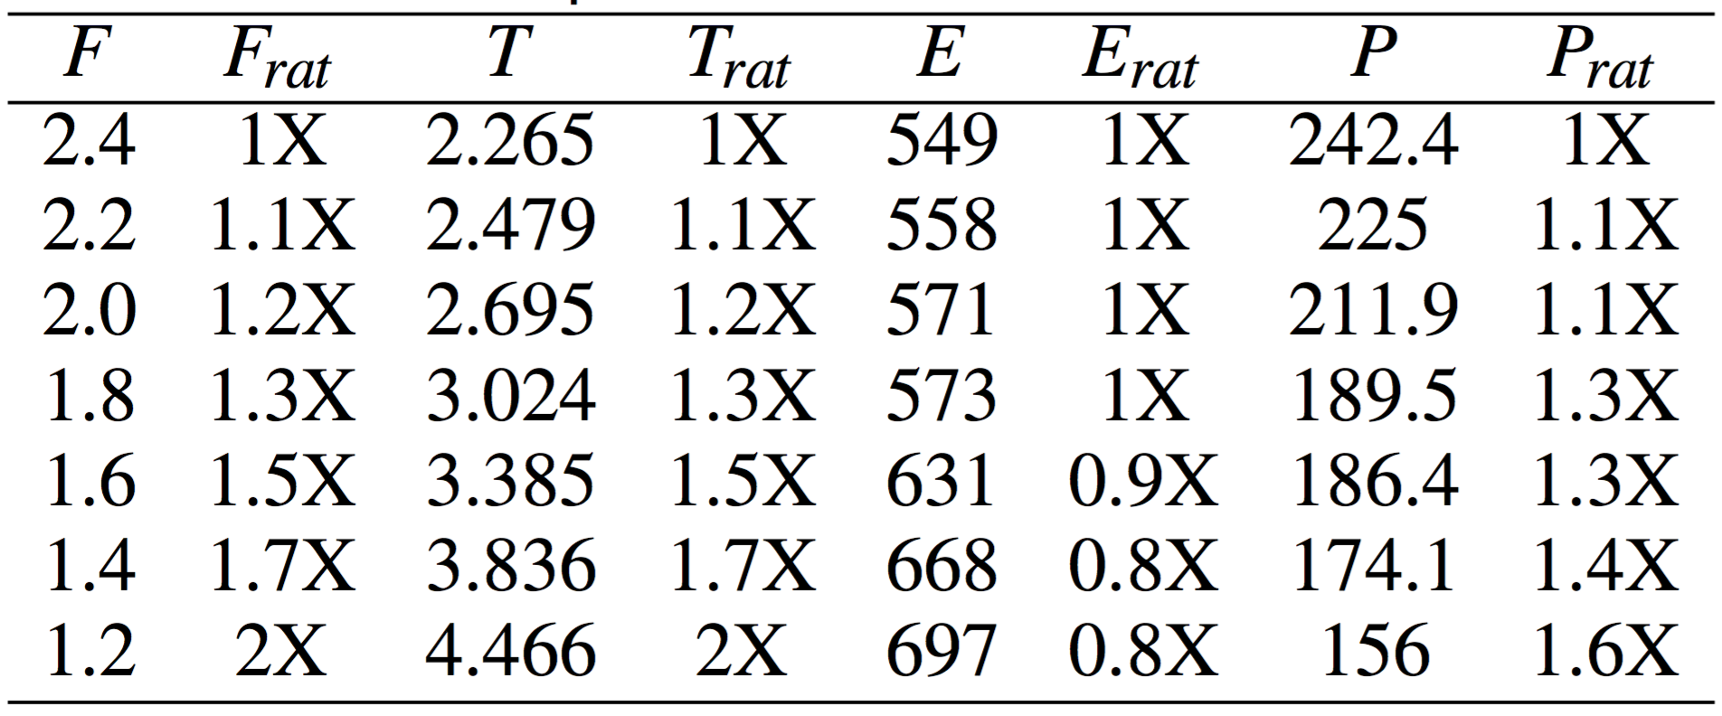
Phase 6 Results: Vary Hardware Architecture
Single clock frequency affects compute units AND shared L3 cache rates on Intel Ivy Bridge
Propositions now unfavorable
Baseline Implementation, Enzo-10M, CPU2, MPI
Notes:
Cache and memory tied together

Slide 48
Outline
Motivation & Background
Strategy & Research Questions
Experimental Overview
Results
Takeaways

Slide 49
Study Takeaways
Isosurfacing is sufficiently data-intensive to gain energy/power savings by reducing the clock frequency
Tradeoffs between runtime and energy/power become more favorable when:
Increasing data set complexity (e.g., size, irregular access patterns)
Heavily stressing memory subsystem (e.g., concurrency)
General-purpose visualization software shifts instruction counts, resulting in less favorable tradeoffs between runtime and energy/power savings

Slide 50
Future Work
Applying factors to more visualization algorithms
i.e., particle advection, volume rendering
Investigate impacts of different architectures
i.e., many-core, GPUs
Notes:
Particle advection: data-dependent memory accesses, which may lead to more favorable propositions
Volume rendering: requires significant computation and irregular memory acceses (especially for unstructured grids)

Slide 51

Exploring Tradeoffs Between Power and Performance for a Scientific Visualization Algorithm
Stephanie Labasan
slabasan@cs.uoregon.edu
http://cdux.cs.uoregon.edu
Thanks!

Slide 52
Phase 4 Results: Vary Concurrency*
Power savings @1 core: MPI and OpenMP save 2.5X
Power savings @4 cores: MPI saves 2.8X and OpenMP saves 2.68X
Increasing concurrency causes more memory requests, leading to memory BW saturation (less instructions executed)*
*performance metrics in paper
Baseline Implementation, Enzo-10M, CPU1, OpenMP/MPI

Slide 53
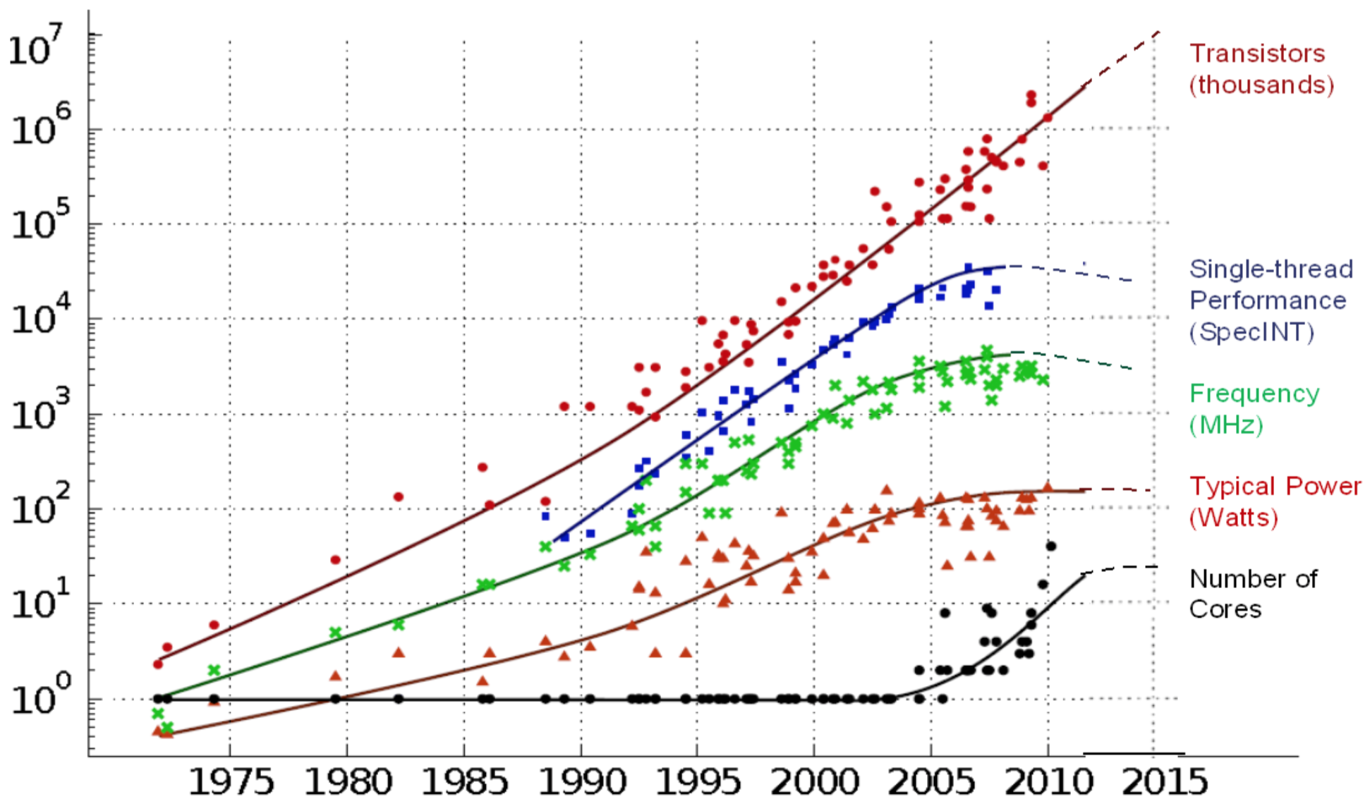
Power Problem*
No longer limited by available HW resources
Thermal heat ≈ CPU frequency
System design shifting from hardware to software design
c/o DoE Exascale Computing Initiative
Notes:
What’s happened? Moore’s law has stayed steady over the years. But we see that the clock speeds and power has saturated starting in 2000 or so. This is because we’ve started to reach our thermal limit and our ability to dissipate the heat generated by the large number of transistors is problematic. The higher the frequency, the larger the power consumption. Because we cannot increase frequency any further, our power consumption has also flattened.
Thus, we’re no longer able to run our processors faster.

